Slide 1

IDETC-CIE Hackathon Task 1: Anomaly Segmentation for Powder Spreading
Hugo Rodriguez and Shengzhe Zhou
Team #33
Bulldogs

Slide 2
Overview
This report documents the current pipeline implemented in the latest code for Task 1 —
Anomaly Segmentation for Powder Spreading. The system:
1. loads the official *.pkl datasets and performs per-condition normalization;
2. early-fuses inputs from conditions a,b,c (use conditions="abc");
3. trains a lightweight Dual-Head U-Net with two heads (streak, spot) under supervised
learning;
4. continues training with Mean Teacher (EMA) for semi-supervised consistency on unlabeled
data;
5. logs and plots loss/IoU curves; and
6. writes predicted streak and bright spot masks directly back into the test-set dictionary,
producing submission task1.pkl.

Slide 3
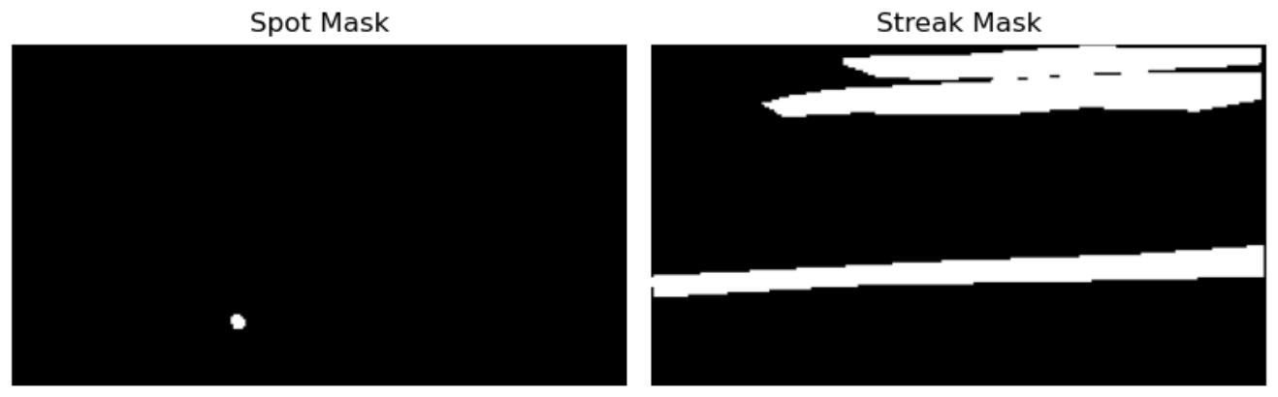
1. Data Pre-processing
Dataset sizes (from the run log).
Labeled: 498 samples;
Unlabeled: 249 samples;
Test: 249 samples.
Label pixel ratios on labeled data (from the log):
Spot = 0.13%
Streak = 13.70%
Imbalaced classes!

Slide 4
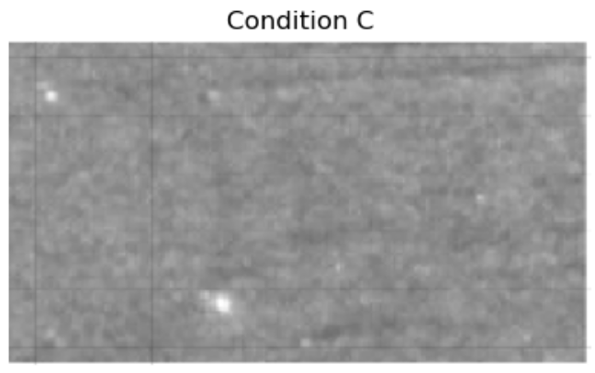

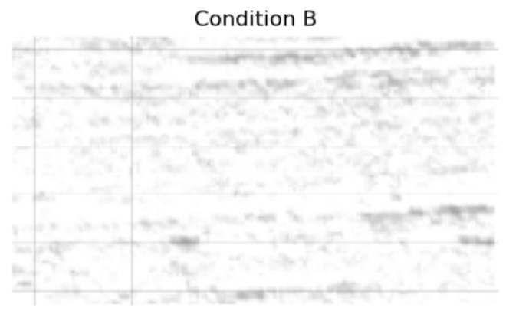
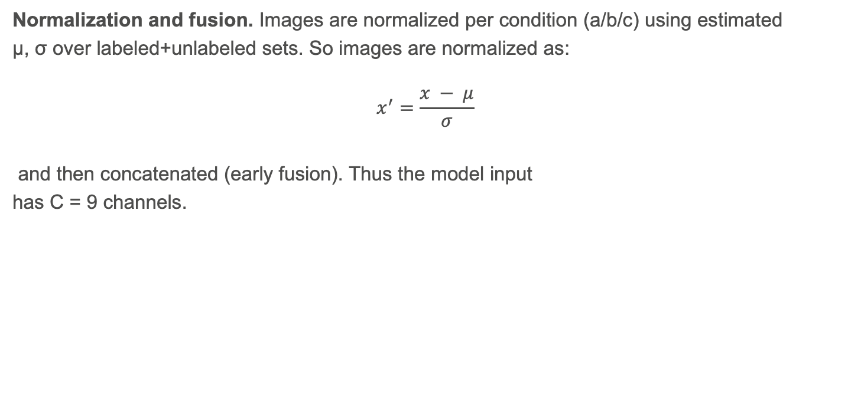
1. Data Pre-processing
Normalization and fusion. Images are normalized per condition (a/b/c) using estimated
μ, σ over labeled+unlabeled sets. So images are normalized as:
$$x^{′}=\frac{x − μ}{σ}$$
and then concatenated (early fusion). Thus the model input
has C = 9 channels.
RGB = 3 channels x 3 = 9

Slide 5
1. Data Pre-processing
Train/Val split and imbalance handling. A stratified random split preserves a fraction
of spot-positive samples across train/val. In the recorded run:
Train: 399 samples (spot-positive count also printed in the log);
Val: 99 samples.
We use:
Pos weight in BCE computed on training pixels:
wstreak ≈ 6.27, wspot = 50.0 (capped).
Sample-level reweighting: spot-positive samples are oversampled (×4).

Slide 6
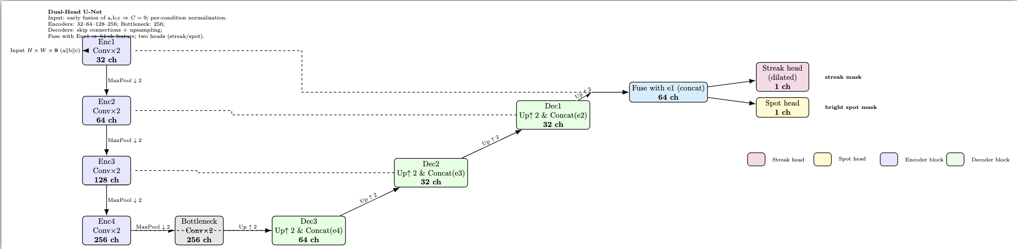
2. Model
The network is a compact U-Net style encoder–decoder with separate heads for streak and
spot. Encoders: [32, 64, 128, 256]; decoder with skip connections; a fusion stage returns a 64-
channel high-res feature used by both heads:
Streak head: includes a dilated conv for longer-range context.
Spot head: standard 3×3 convs to preserve small details.
Parameter count in the log: 1.41M.
Notes:
Question: How did we decide the weight on the BCE on pixels?

Slide 7
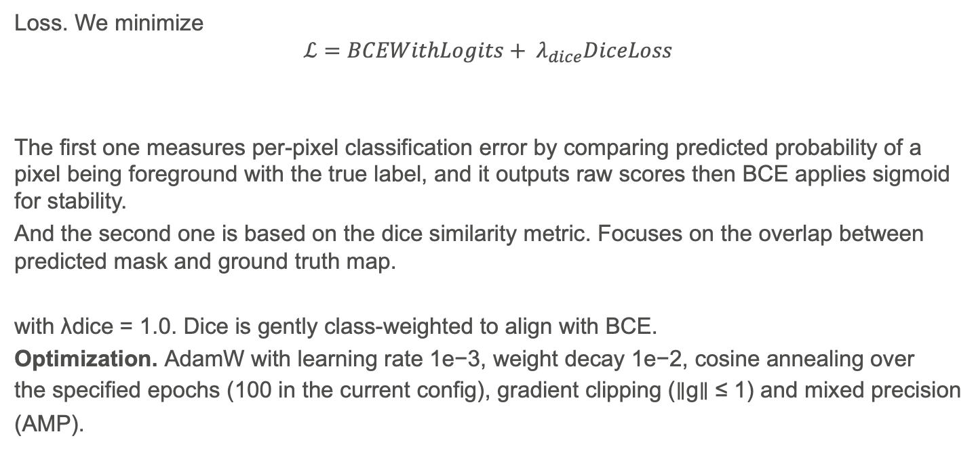
3. Training Objectives and Optimization
Loss. We minimize
$$ℒ=BCEWithLogits+ λ_{dice}DiceLoss$$
The first one measures per-pixel classification error by comparing predicted probability of a pixel being foreground with the true label, and it outputs raw scores then BCE applies sigmoid for stability.
And the second one is based on the dice similarity metric. Focuses on the overlap between predicted mask and ground truth map.
with λdice = 1.0. Dice is gently class-weighted to align with BCE.
Optimization. AdamW with learning rate 1e−3, weight decay 1e−2, cosine annealing over
the specified epochs (100 in the current config), gradient clipping (∥g∥ ≤ 1) and mixed precision
(AMP).
With pos_weight
Per class
Notes:
Question: How did we decide the weight on the BCE on pixels?

Slide 8
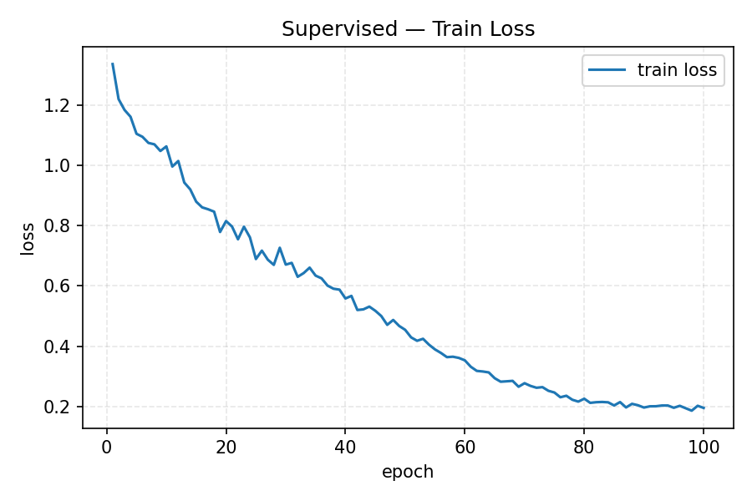
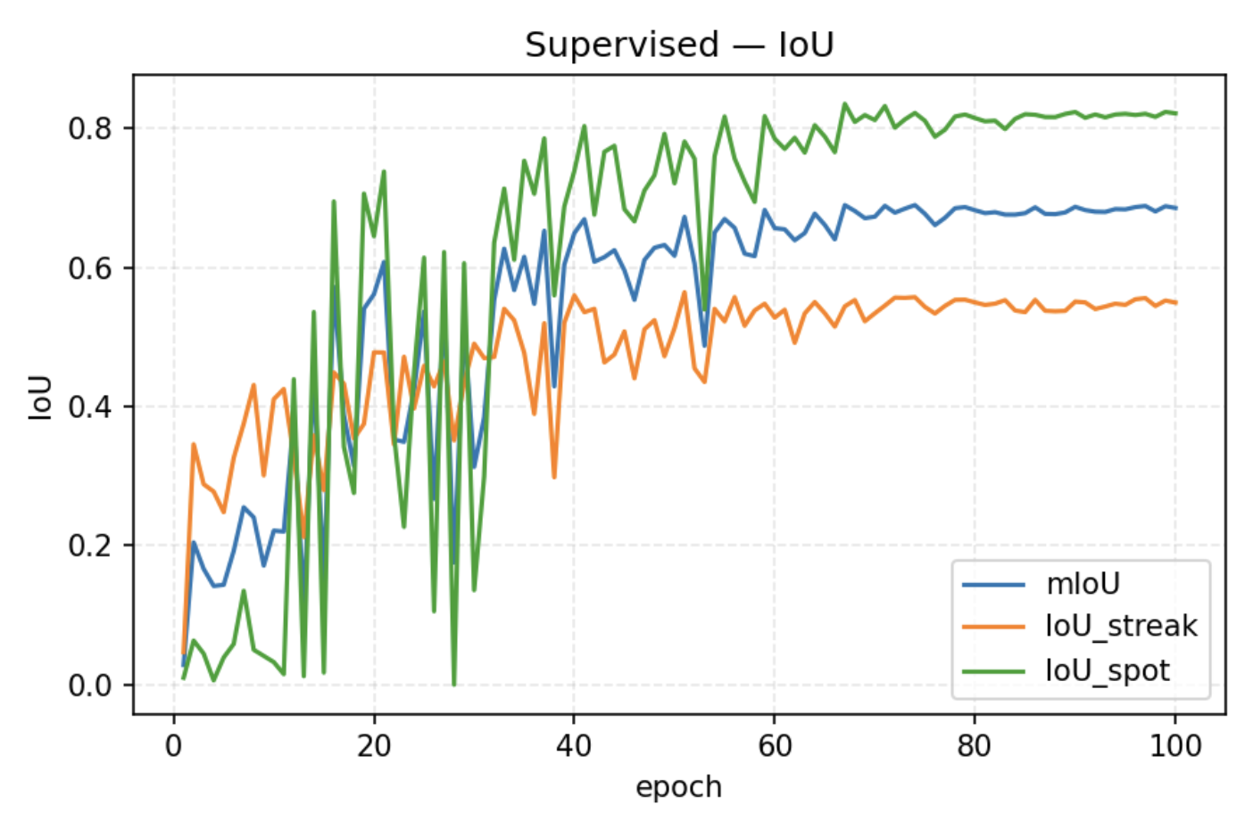
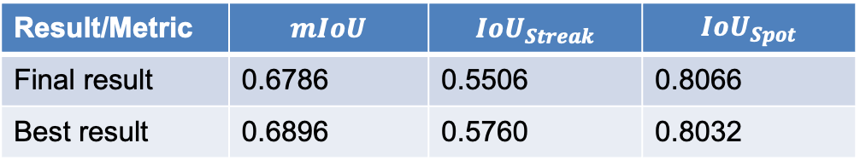
4. Supervised Results (Validation)
Across 100 epochs, the best unsupervised validation results metrics observed in the log were:
Result/Metric | $$mIoU$$ | $${IoU}_{Streak}$$ | $${IoU}_{Spot}$$
Final result | 0.6786 | 0.5506 | 0.8066
Best result | 0.6896 | 0.5760 | 0.8032
Notes:
Question: How did we decide the weight on the BCE on pixels?

Slide 9
5. Semi-Supervised: Mean Teacher (EMA)
We then switch to a Mean Teacher setup:
Teacher parameters training: Exponential Moving Average EMA(θ) of the student with decay α = 0.999;
Views: weak augmentation to teacher, strong augmentation to student (brightness/contrast jitter, noise/blur, random flip);
Pseudo labels: hard masks from teacher probabilities with per-class thresholds τstreak = 0.90, τspot = 0.70; the unsupervised loss is masked BCE at confident pixels;
Ramp-up: unsupervised weight linearly increases during the first 5 epochs.
Notes:
Question: How did we decide the weight on the BCE on pixels?

Slide 10
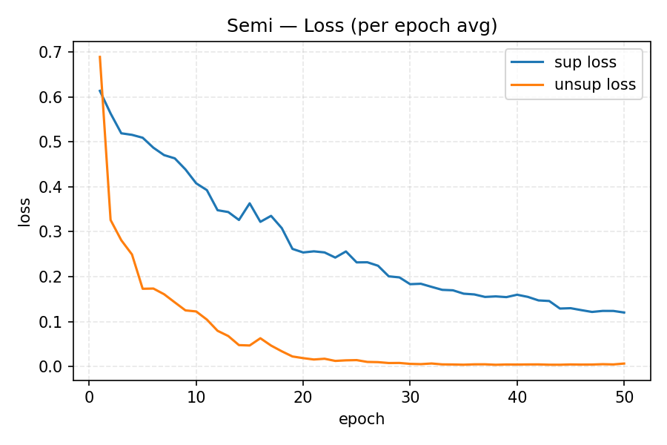
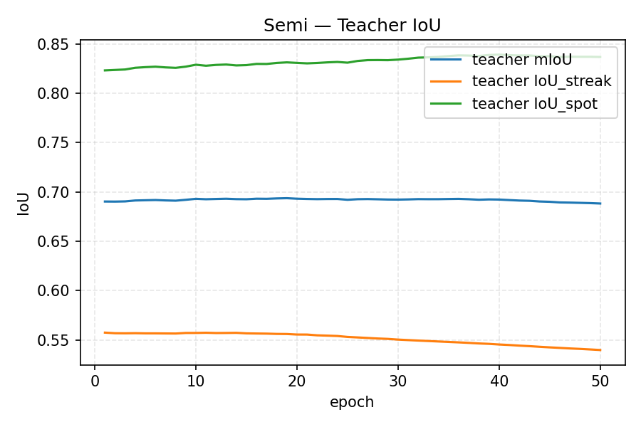
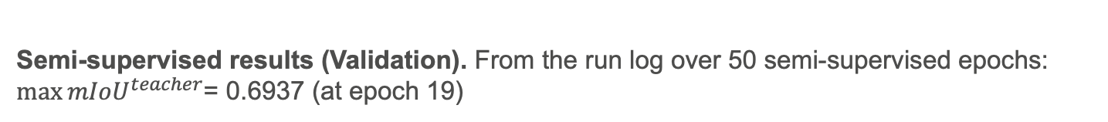
5. Semi-Supervised: Mean Teacher (EMA)
Semi-supervised results (Validation). From the run log over 50 semi-supervised epochs: $\max{{mIoU}^{teacher}}$= 0.6937 (at epoch 19)
Notes:
Question: How did we decide the weight on the BCE on pixels?

Slide 11
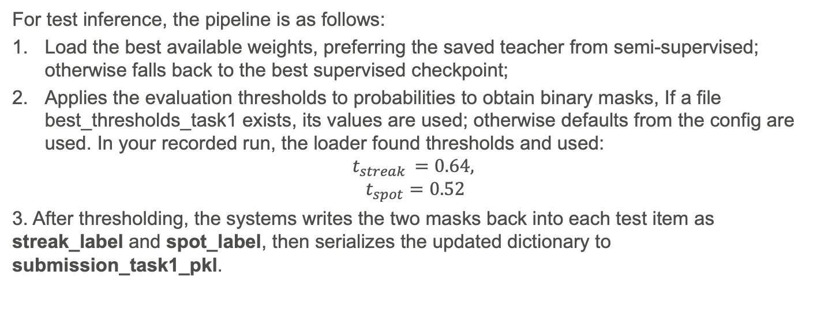
6. Submission Writing (test set)
For test inference, the pipeline is as follows:
Load the best available weights, preferring the saved teacher from semi-supervised; otherwise falls back to the best supervised checkpoint;
Applies the evaluation thresholds to probabilities to obtain binary masks, If a file best_thresholds_task1 exists, its values are used; otherwise defaults from the config are used. In your recorded run, the loader found thresholds and used:
$$t_{streak }=0.64,$$
$$t_{spot}=0.52$$
3. After thresholding, the systems writes the two masks back into each test item as streak_label and spot_label, then serializes the updated dictionary to submission_task1_pkl.
Notes:
Question: How did we decide the weight on the BCE on pixels?

Slide 12
IDETC-CIE Hackathon Task 2: Generation of Synthetic Powder Spreading Images
Hugo Rodriguez and Shengzhe Zhou
Team #33
Bulldogs

Slide 13
1. Model Selection: Model Architecture
Denoising Diffusion Implicit Model was selected as generative model:
U-Net
Image batch
Predicted Noise
Encoder Block
Sinusoidal Time Embedding
Decoder Block
Convolutional layer
Conv2D
Convx2
Up 2 & Concat
Width = 32
Width = 32
Convx2
Up 2 & Concat
Width = 64
Width = 32
Convx2
Up 2 & Concat
Width = 128
Width = 64
Convx2
Width = 256

Slide 14
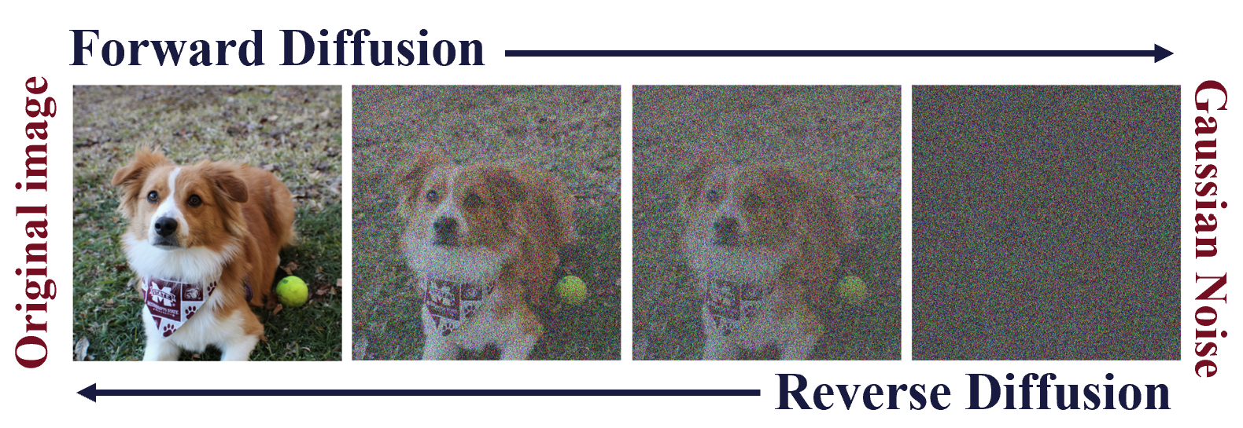
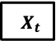
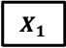
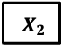
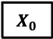
1. Model Selection
DDIM leverages the U-net structure to add noise and eliminate it using forward and backword process and learns how to generate the original images distribution from random noise.
Forward Diffusion
$$X_{0}$$
$$X_{1}$$
$$X_{2}$$
$$X_{t}$$
Original Image
…
Gaussian Noise
Reverse Diffusion

Slide 15

2. Model Results
The generated images are plotted by different lighting conditions to evaluate the models capacity to generate realistic images.

Slide 16
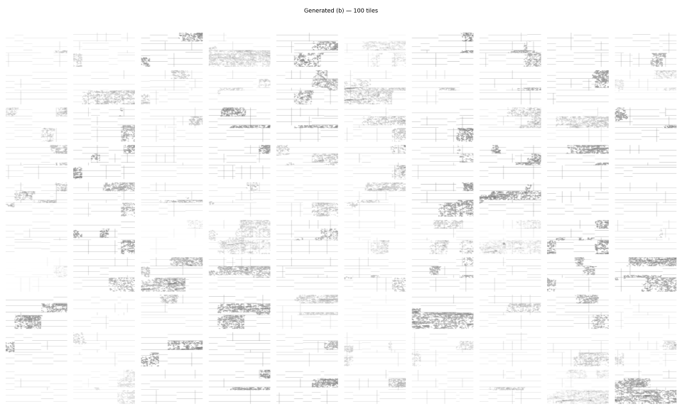
2. Model Results
The generated images are plotted by different lighting conditions to evaluate the models capacity to generate realistic images.

Slide 17
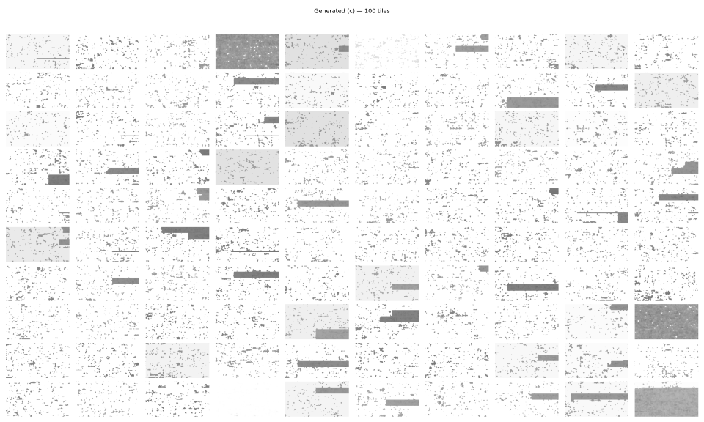
2. Model Results
The generated images are plotted by different lighting conditions to evaluate the models capacity to generate realistic images.

Slide 18
2. Model Results
And finally, the evaluation metrics are computed:
Lighting Condition | FID | LPIPS
a | 159.61 | 0.3677
b | 319.58 | 0.6253
c | 277.43 | 0.6739

